Slide 1

Annual Meeting 2025

Slide 2
Board Members:
Deborah Cohen – Chair
Carrie Koeller – Vice Chair
Jim Mayer – Secretary
Rene Vega – Commissioner
Julien Marin-Couilloud – Commissioner
Kimberley Thompson - Commissioner
Open board position for 1 renter

Slide 3
The Tower Grove South Concerned Citizen Special Business District was approved by voters in 2008 as a “Special Taxing District”
In 2018, voters approved to extend the SBD through 2033
The primary purpose is to provide enhanced safety for the District, which includes:
private patrols (off-duty City of St. Louis Police officers and unarmed security guards);
enhanced lighting;
security camera installation;
trash pickup and street saling;
crime/safety education;
and other safety-related services to residents living within the District.
Funded 100% by property taxes:
Not a Community Improvement District or Tax-Increment Financed (which are funded by sales tax revenue);
Revenue received by City of St. Louis in Feb/Mar following the close of each tax year (12/31);
The tax rate for 2024 will be set at $0.5610 per $100 of assessed value;
The maximum tax rate allowable by law is $0.71;
Tax rate increases are the decision of the Board and do not require a vote by taxpayers.

Slide 4
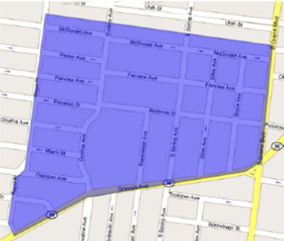
Boundaries
West: Roger Place;
South: Gravois Ave to Phillips/Roger;
East: Grand Boulevard;
North: Alley between Utah Place and McDonald Avenue.

Slide 5
Income
 | 2025-Budg | 2025-Act | 2026-Budg
Carryover From Prior Year | $230,938 | $214,305 | $240,528
 |  |  | *we still have several projects in process
Bank Interest | $1,500 | $8,414 | $5,000
Property Tax | $115,000 | $138,610 | $115,000
Subtotal - Revenue | $116,500 | $147,024 | $115,000
Subtotal - Revenue & Carryover | $347,438 | $361,329 | $355,528

Slide 6
Expenses
 | 2025 Budg | 2025-Act | 2026-Budg
Subtotal - Operating Expenses (admin, IT, insurance, legal) | $19,300 | $2,961 | $21,500
Programs (clubs, comm ed & safety | $0 | $0 | $4,000
Tree Maintenance |  |  | $30,000
Weather Related |  |  | $5,000
Security Cameras - Install | $30,000 | $15,174 | $30,000
Security Cameras - Maintenance | $10,000 | $2,013 | $10,000
Traffic Calming | $53,000 | $0 | $65,000
Trash Pickup | $16,000 | $3,000 | $16,000
Security Patrols | $75,000 | $36,855 | $75,000
Subtotal - Expenses | $203,300 | $60,003 | $256,500
(Rev + Carry-over Less Exp) |  |  | $99,028

Slide 7

Snow Management
During last winter’s deep freeze, TGSCC board voted to salt the streets of the district twice.
We will do the same this winter should the need arise.

Slide 8

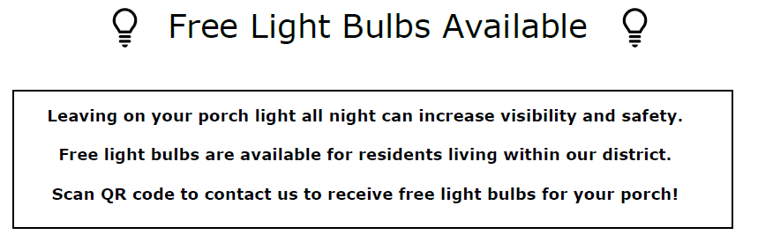
Light bulbs
We have started our “Leave the Lights On” campaign.
To encourage you to turn your outdoor lights on, we are giving away light bulbs to residents who request them.
Go to our website tgscc-stl.org to request them.
Or email chair@tgscc-stl.org

Slide 9
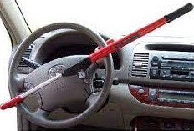
Car Clubs
We have purchased car clubs to give away to residents of the district for free!
Please see one of us to get yours today.
Notify your neighbors and have them reach out to us.
One can be requested through our website tgscc-stl.org
Residency in district required.

Slide 10

Trash Pick Up
2025 – Partnered with Regency Enterprises for scheduled service every other month for regular maintenance of streets and alleys (not to overlap with bulk pick up week)
2026 – To continue with this service

Slide 11

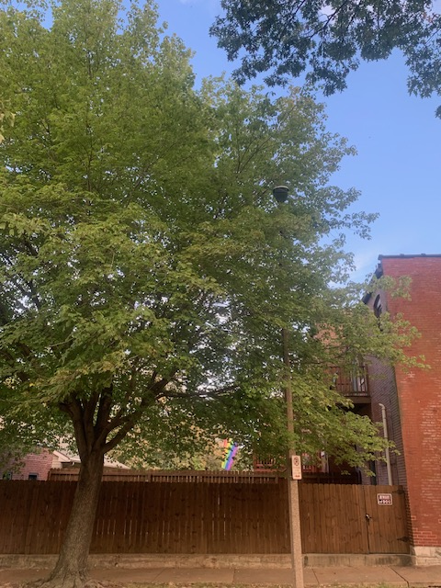
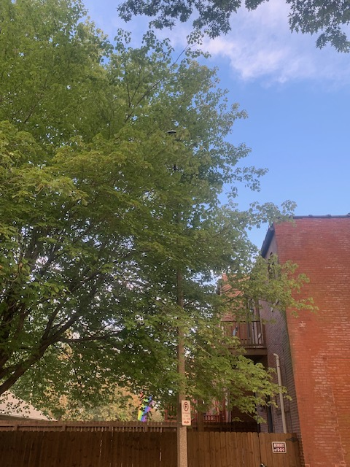

Tree Maintenance
Began September 29th
Done for Safety
Clearance from stop signs
Visibility around streetlights
Removal of dead, dying, diseased, and broken limbs
Notes:
Process started in Nov 2024
Connected with the city and Davey Tree – Certified Arborists
Why Davey- provided same service in Soulard SBD
Certified arborists
Identified 54 tree in need of attention
Reviewed with City to designate number to be removed and number to be trimmed
Several Ash which the city will remove
Final plan to trim 37 trees in the district
Clearing/pruning
6-10’ of traffic signage and signals- making signage visible for 35’
8-10’ over sidewalks
15-18’ over roadways
Crown cleaning and hazard mitigation
Removal of dead, dying, diseased, broken limbs and stubs
Includes removal and disposal of limbs
Cost $25,920
2026 looking into Tree removal.

Slide 12
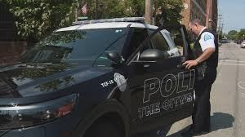

Security Patrols
Security is patrolling for safety and security of people and property.
Security patrol is within boundaries of SBD.
4-6 hours per day
5-7 days a week
Security is made aware of problem properties.
Patrol schedule is not made public to ensure greater effectiveness.
Schedules and focus subject to regular adjustments.
The City’s Finest Patrols Also Play a Very Important Preventive Role

Slide 13
Crime Data
Input from residents is important as it complements crime data and feedback from patrols.

Slide 14
Safety Tips
Keep doors and windows locked.
Secure windows and central air conditioning units to prevent break-ins and theft.
Never leave valuables or other items in your vehicle.
Leave your porch lights on at night.
Report all crime or suspicious activity by dialing 9-1-1.
Have keys in your hand when walking to your car.
Be aware of your surroundings … don’t walk and talk on your cell phone.
Walk with a purpose and make eye contact with passersby.
TRUST YOUR INTUITION

Slide 15
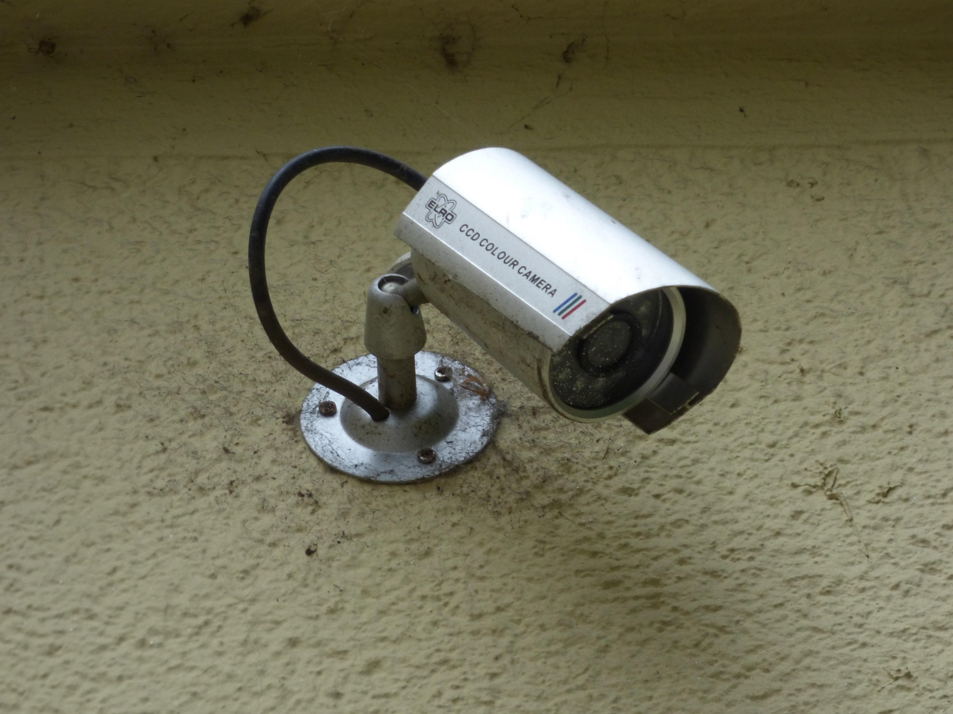
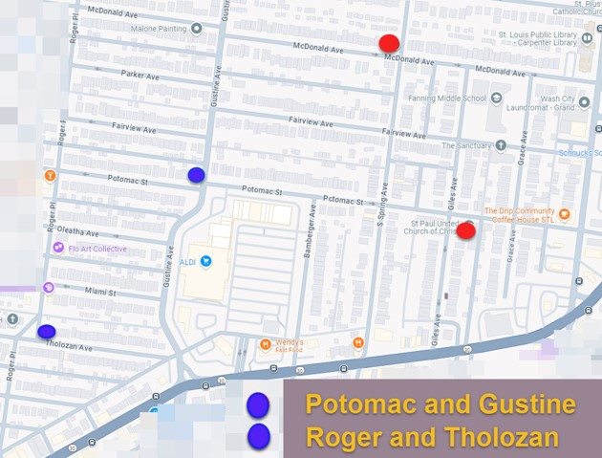
Cameras
Fed into the STLMPD Real Time Crime Center
https://slmpd.org/rtcc/
We are looking for more locations to place cameras
Please notify us if you have a property that would a good location for a camera

Slide 16
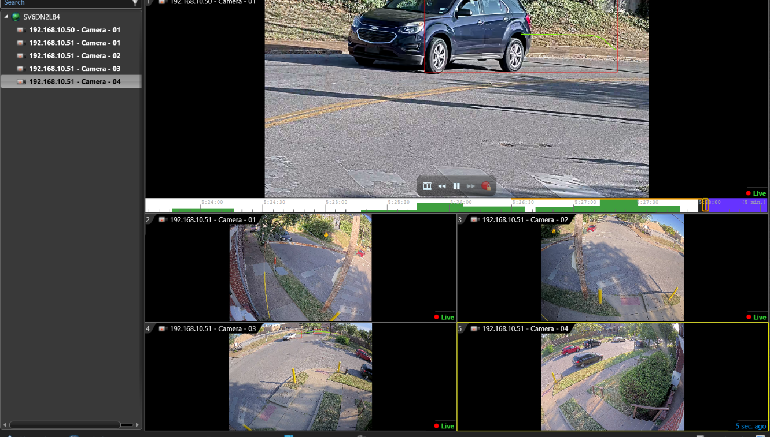
Potomac and Gustine

Slide 17
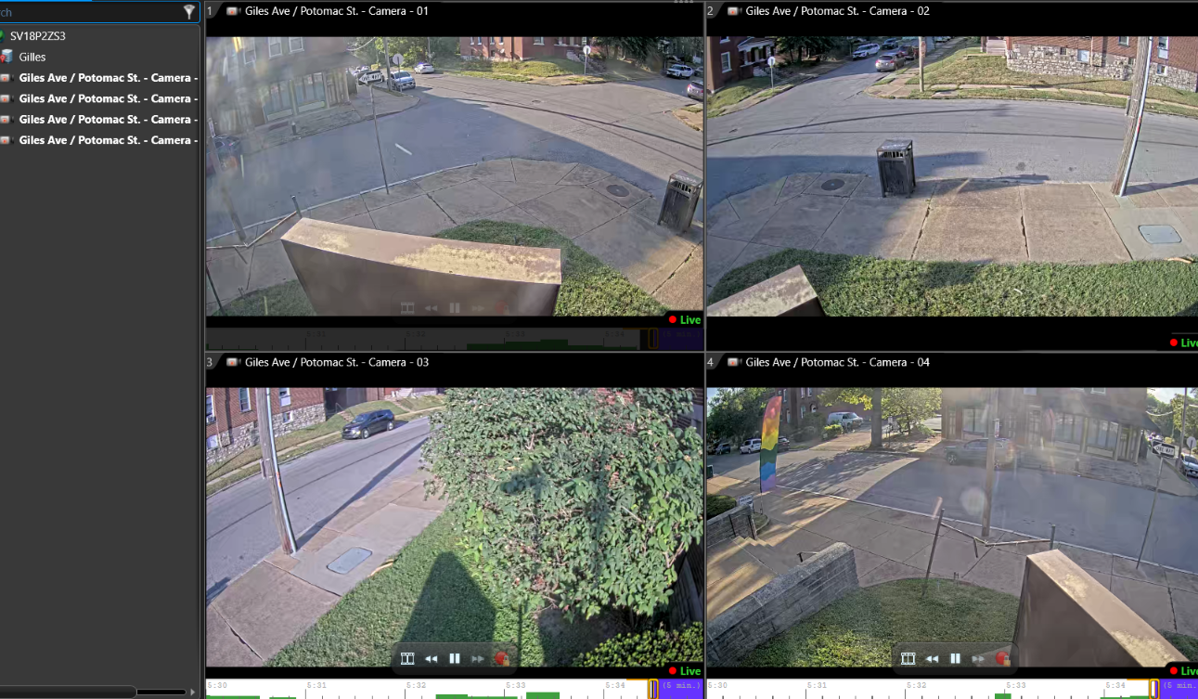

Slide 18
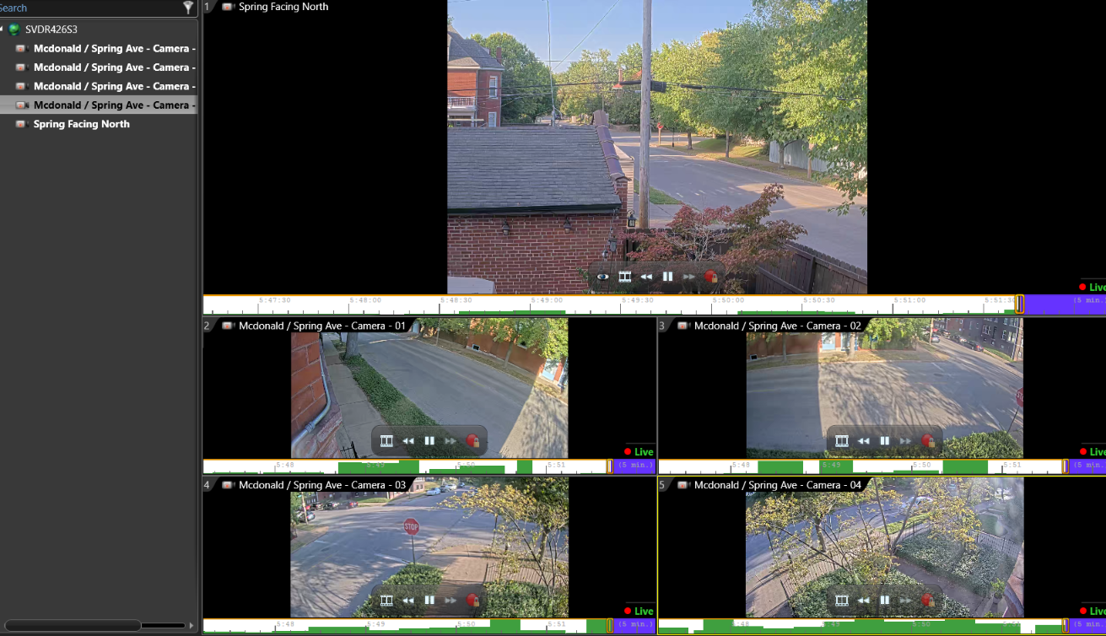

Slide 19
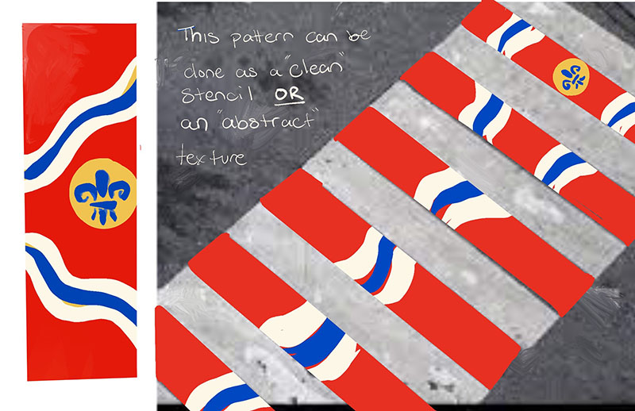
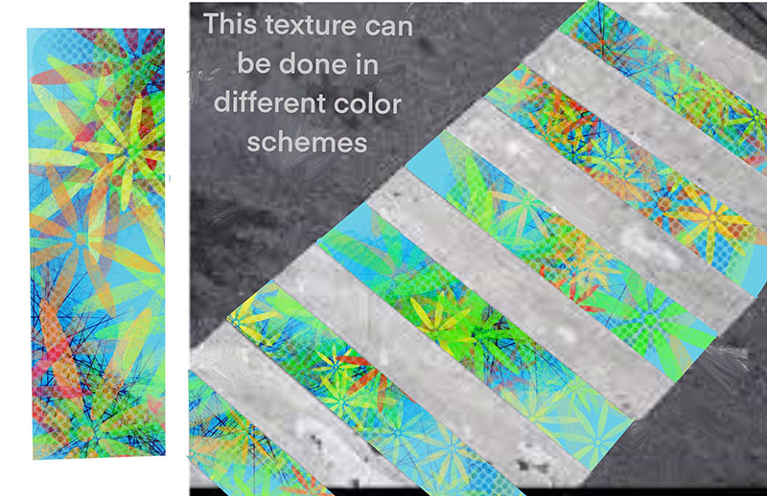
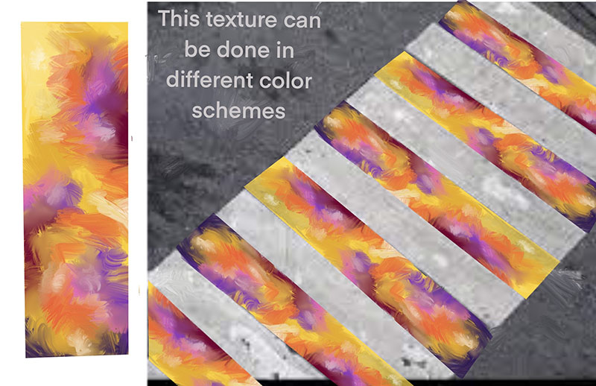
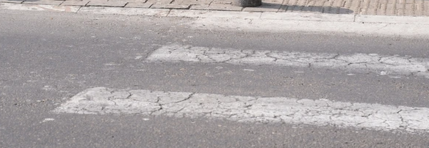
Pedestrian Safety
We are currently working with the 6th Ward office to offer a proposal to the city enhance crosswalks within our district at 6 intersections where crosswalks already exist

Slide 20


Questions and Comments
Please complete and index card with the top 1 or 2 ideas or projects you would like to see the board focus on

